Slide 1
CHAPTER 9
Customer-Defined Service Standards

Slide 2
Chapter Objectives
Distinguish between company-defined and customer-defined service standards.
Differentiate between “hard” and “soft” customer-defined standards and one-time fixes.
Illustrate how to translate customer expectations into behaviors and actions.
Explain the process of developing customer-defined service standards.

Slide 3
Company-Defined Standards
Standards that are established to reach internal company goals for productivity, efficiency, cost, or technical quality.
  Ex: using an automated voice system even though customers complain about them. They save companies money.
Company-defined standards are not successful in closing gap 2, that is why we need customer-defined standards.
  Example: Firm may incorporate AI in customer support to reduce cost and improve efficiency. However, AI may not solve nuanced issues, thereby failing to close Gap 2.

Slide 4
Customer-Defined Standards
Operational standards based on pivotal customer requirements identified by customers.
These are deliberately chosen to match customer expectations and to be calibrated the way the customer views and expresses them.
Anchoring service standards on customers can also save a firm money!
Notes:
Example: reduce customer wait time

Slide 5
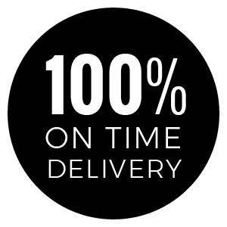
Types of Customer-Defined Service Standards
Hard customer-defined standards: things that can be counted, timed, or observed.
  Ex: FedEx – on-time delivery, delivery to wrong addresses, failed delivery, customer contact with employee, and customer satisfaction.

Slide 6

Types of Customer-Defined Service Standards
Soft customer-defined standards: opinion-based measures and cannot be directly observed – “understanding the customer”.
  Ex: Restaurant – providing enough attention and respect to guests by having employees display a polite demeanor, greetings, and during interactions.

Slide 7
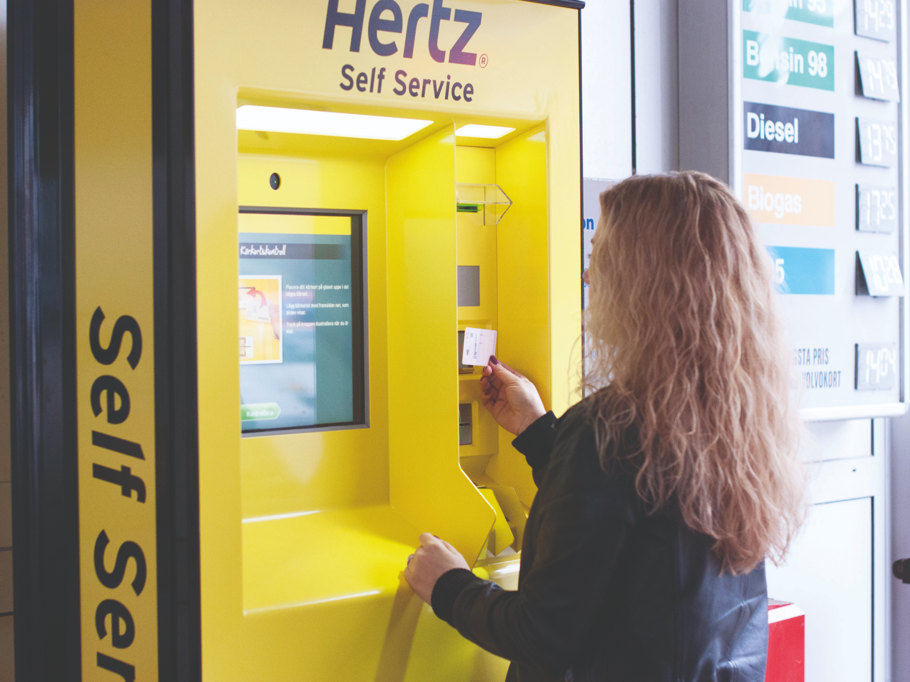
One-Time Fixes
Technology, policy, or procedure changes that, when instituted, address customer requirements.
Company standards that can be met by a business making a one-time change that does not involve employees and therefore does not require motivation and monitoring.
Notes:
Example: Hertz’s express checkout allowing reduction in long customer wait times

Slide 8
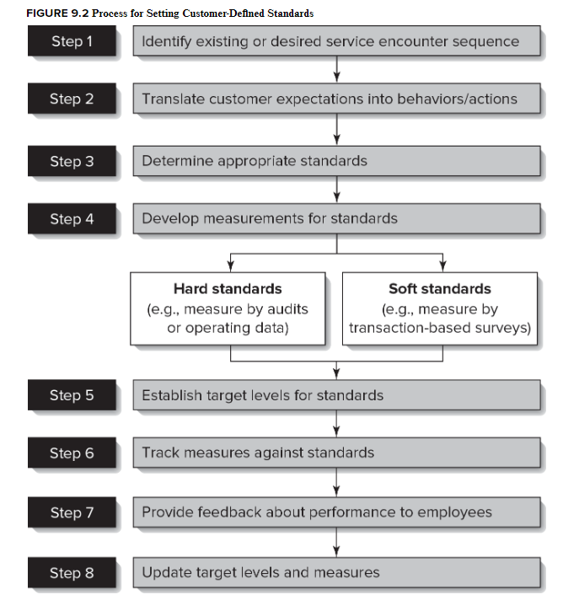
Turning customer requirements into specific behaviors and actions
Top of service blueprint
Using this framework, let’s apply this to a business and walk through the steps together.

Slide 9
Development of Customer-Defined Service Standards
Identify existing or desired service encounter sequence – top line of service blueprint
Translate customer expectations into specific behaviors and actions – abstract to concrete
Notes:
1: List the sequential steps and activities that customer experiences in receiving the service (top line of service blueprint) – first and last encounters are really important.
2: Abstract customer requirements should be translated into concrete, specific behaviors and actions associated with each service encounter – satisfaction to deliver within 48 hours.
3: Determine if hard or soft standards should be used – should not be done hastily.
4: Develop feedback measures to adequately capture the standards.

Slide 10
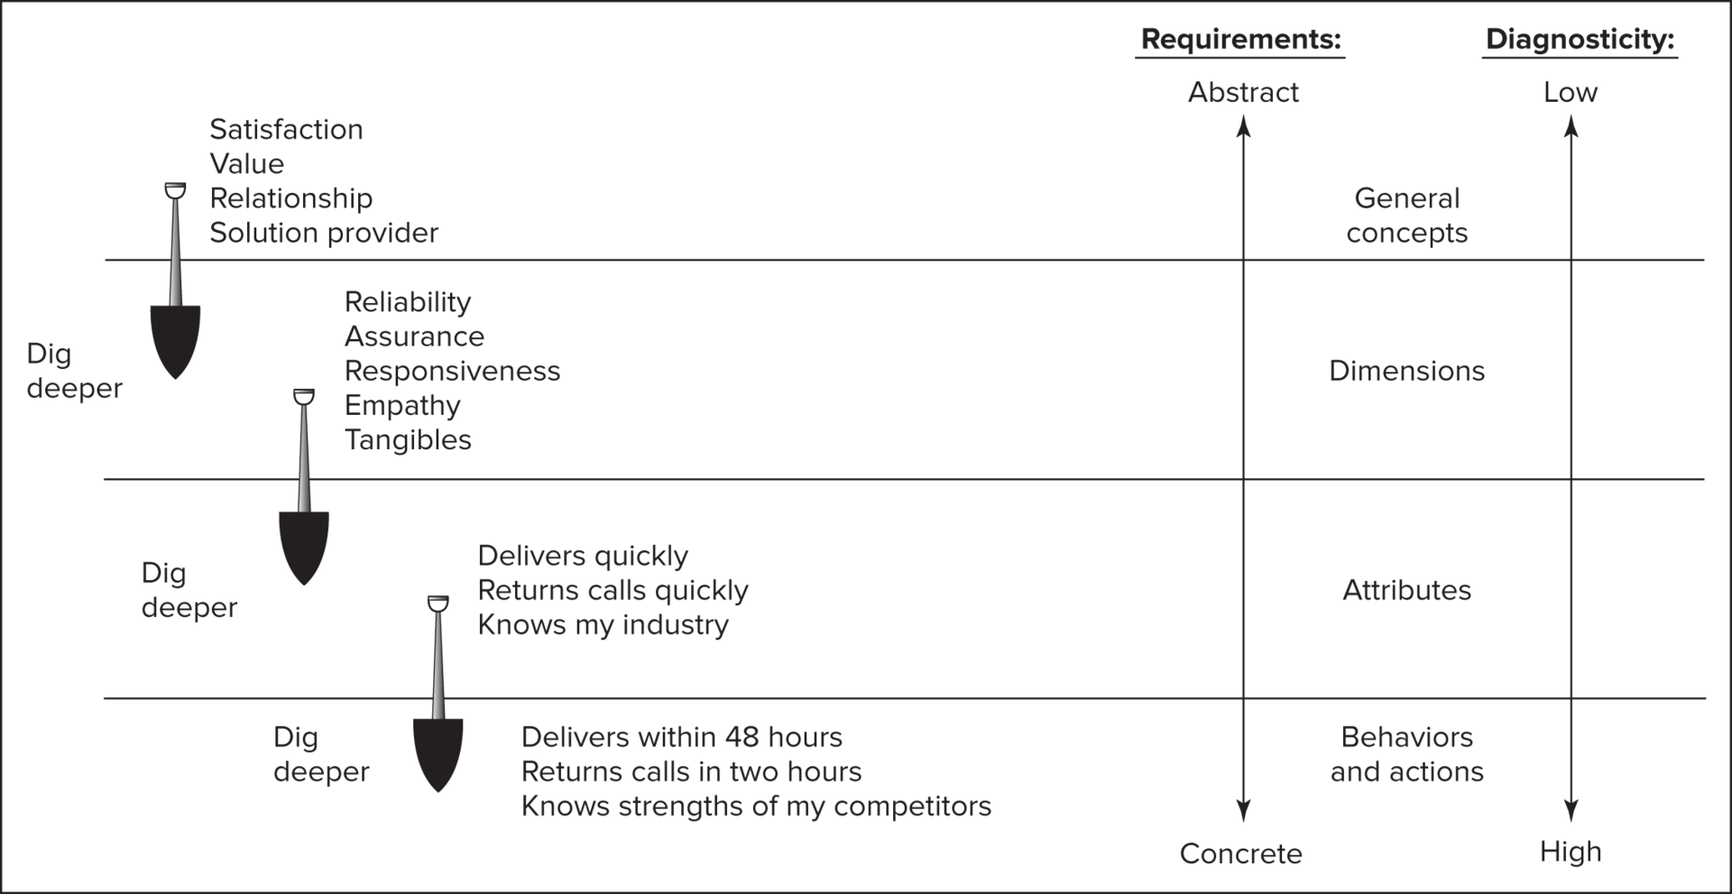
Translate customer expectations into specific behaviors and actions – abstract to concrete

Slide 11
Development of Customer-Defined Service Standards
Determine appropriate standards – hard/ soft/ both
Develop measurements for standards
  Hard measurements: mechanical counts/ technology enabled measurements of time or errors (e.g., missing packages).
  Soft measurements: based on customer perceptions that cannot be often directly observed (use surveys to measure).
Establish target levels for the standards.
Track measures against standards –whether standards are being met.

Slide 12
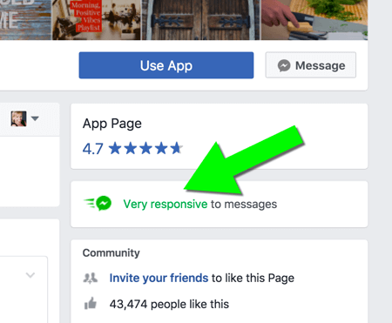
Development of Customer-Defined Service Standards
Provide feedback about performance to employees (e.g., through employee monitoring and listening).
Periodically update target levels and measures – revise target levels, measures, and customer requirements regularly to keep up with customer expectations.

Slide 13
Let’s apply this framework to airline services!

Slide 14
Step 2: Translate Customer Expectations
Online booking
Check-in process
Security & boarding
In-flight experience
Baggage claim
Customer support

Slide 15
Step 1: Identify Service Encounter Sequence
Fast and easy online booking
Smooth check-in with minimal wait times
Clear and timely boarding process
Friendly and responsive flight attendants
Reliable baggage handling
Quick and effective customer service

Slide 16
Step 3: Determine Appropriate Standards
Online booking < 3 min, no errors
Check-in < 5 min per customer
Boarding announcements timely & clear
Flight attendants respond within 3 min
Baggage delivery < 15 min after landing
Customer complaints acknowledged within 24 hours

Slide 17
Step 4: Develop Measurements for Standards
Hard Standards:
  % of customers completing booking in 3 min
  Check-in wait time metrics
  Baggage delivery times
Soft Standards:
  Customer surveys
  Passenger feedback on service quality
  Net Promoter Score (NPS)

Slide 18
Step 5: Establish Target Levels
95% of bookings completed in 3 min
90% of check-ins under 5 min
85% of passengers rate service 'Excellent'
99% baggage delivered in 15 min
90% customer complaints resolved within 24 hours

Slide 19
Step 6: Track Measures Against Standards
Online analytics for booking time
Automated wait-time monitoring at check-in
RFID tracking for baggage
Post-flight surveys & complaint tracking

Slide 20
Step 7: Provide Feedback to Employees
Share performance data with teams
Train flight attendants for faster response times
Conduct monthly performance reviews
Improve check-in and baggage handling process

Slide 21
Step 8: Update Target Levels and Measures
Introduce AI chatbots for customer support
Use biometric check-in to reduce wait times
Improve baggage tracking with real-time notifications
Adjust targets based on customer feedback

